Slide 1
AP Capstone Presentation
Presented by: Deana DeWitt
3/5/19

Slide 2
Transitioning from Senior Exhibition to AP Capstone
BACKGROUND of Exhibitions
Senior Exhibition has been a source of pride and a signature feature of the SRRHS educational experience for 20+ years.
Provides a culminating experience, allowing students to demonstrate mastery of skills and characteristics necessary for success in college and career.
Exhibitions is a one-semester course (0.5 credits) required for graduation. Students go through the process of proposing, planning, and completing a college-level research paper or project. Students then present their Exhibition to a panel of judges.
Students attend class and are also assigned a faculty sponsor for support in completing their Exhibition.

Slide 3
Transitioning from Senior Exhibition to AP Capstone
CHALLENGES with Exhibitions
Changing demographic and diverse student needs
Competing with nearby and online schools that do not have this graduation requirement
Student interest in increased offerings of CTE courses that result in industry certification
Increasing faculty workload
Faculty lacks expertise
Expectations inconsistent with the level of rigor in previous courses (K-12)

Slide 4
Transitioning from Senior Exhibition to AP Capstone
SOLUTIONS of AP Capstone
Two-year study to prepare for the culminating project, increasing the depth/breadth of the experience
Norm-referenced, rigorous expectations backed by College Board
College credit at over 250 colleges/universities worldwide
Increased flexibility in scheduling for students who wish to enroll in CTE programming
Multiple pathways to high school graduation, college, and careers
Reduced workload for staff
Increased focus and expectation for more rigorous instruction in every class/content area (K-12)

Slide 5
What is the AP Capstone Program?

Slide 6
https://www.youtube.com/watch?v=yPsQvn6NaLE&feature=youtu.be

Slide 7
Introducing - AP Capstone
is an innovative program that allows students to engage in rigorous college-level study of the critical skills necessary for success in college. The program of study includes a two-course sequence:
AP Seminar and AP Research
Emphasizes Critical Skills
Complements the in-depth subject-matter study in AP
Considering multiple perspectives
Careful evaluation of information
Writing evidence-based arguments
Identifying and solving problems
Oral communication and defending an argument
Collaboration and teamwork
Notes:
Beginning in fall 2014, the College Board’s Advanced Placement Program will offer AP Capstone™.
Developed at the request of College Board Higher Education membership and currently being piloted in 17 schools worldwide, AP Capstone is built on the foundation of a new two-year high school course sequence and is designed to complement and enhance the in-depth, discipline-specific study provided through other AP courses.
The AP Capstone curriculum fosters inquiry, research, collaboration, and writing skills through the intensive investigation of topics from multiple perspectives.

Slide 8
AP Seminar – Starting Fall 2019
Typically taken in grade 10 or 11.
Students learn how to:
Exam score based on:
Example Topics
Democracy
Education
Revolution
Freedom
Protest
Technology
Sustainability
Investigate real-world topics from multiple perspectives
Carefully analyze information, write evidence-based arguments and effectively communicate them
Work independently and with a team to research a topic, develop a written report and deliver a presentation
Team Project & Presentation
25%
2. Individual Essay & Presentation
35%
Written Exam
40%
Teachers & Students select and study 2-4 topics.
Notes:
AP Seminar is a foundational course that aims to equip students with the power to analyze and evaluate information with accuracy and precision in order to craft and communicate evidence-based arguments. Using an inquiry framework of questioning, understanding, evaluating, synthesizing, and transforming, students practice reading and analyzing articles, research studies, foundational, literary, and philosophical texts; listening to and viewing speeches, broadcasts, and personal accounts; experiencing artistic works and performances; conducting research and evaluating evidence; constructing and supporting arguments; and collaborating and communicating. The course topics and themes engage students in cross curricular conversations that explore the complexities of academic and real-world topics and themes through the examination of divergent perspectives.
Students engage in conversations about complex academic and world issues through a variety of lenses, considering multiple points of view to can gain a rich appreciation for and understanding of the complexity of important issues. Teachers have the flexibility to choose 2-4 appropriate topics or themes that allow for deep exploration based on:
Students are assessed through two through-course performance assessment tasks and a written exam. The following assessments are summative and will be used to calculate a final AP Score (using the 1-5 scale) for AP Seminar.

Slide 9
AP Research – Starting Fall 2020
Students learn how to:
Exam score based on:
Design, plan, and conduct a year-long mentored, research-based investigation
Apply research methods and practices to address a real-world topic selected by the student
Write a college-level research paper, present and orally defend the findings and research methodology
Research Process
15%
Academic Thesis Paper (~5,000 words)
70%
Public Presentation and Oral Defense
15%
AP Seminar is a prerequisite to AP Research.
Notes:
The second course in the Capstone experience allows students to explore deeply an academic topic, problem, or issue of individual interest. Through this inquiry, students design, plan, and conduct a year-long mentored, research-based investigation to address a research question.
In the AP Research course, students further their skills acquired in the AP Seminar course by understanding research methodology; employing ethical research practices; and accessing, analyzing, and synthesizing information as they address a research question. The course culminates in an academic thesis paper of approximately 5,000 words and a presentation, performance, or exhibition with an oral defense.
AP Seminar is a prerequisite to AP Research.

Slide 10
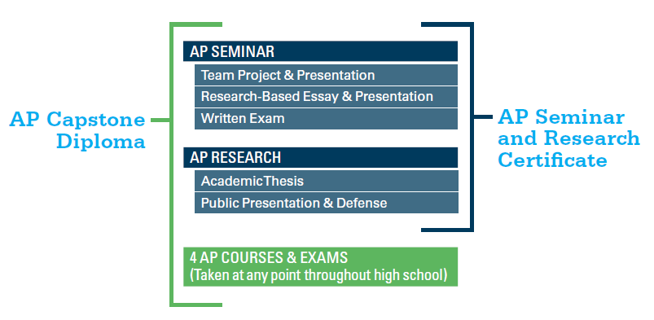
AP Capstone Program Model
A two-course sequence that provides students with the critical thinking and research skills needed to succeed in college and stand-out in the admission process
AP Capstone Diploma™
AP Research & Seminar Certificate™
Students who earn scores of 3 or higher on the AP Seminar and AP Research Exams and on four additional AP Exams of their choosing will receive the
AP Capstone Diploma™.
Students who earn scores of 3 or higher on the AP Seminar and AP Research Exams only will receive the AP Seminar and Research Certificate™
Notes:
AP Capstone promotes student engagement with rigorous college-level curricula and allows students to choose the AP courses in pursuit of the AP Capstone Diploma.
The AP Capstone Diploma Option provides a framework for students taking multiple AP Courses to distinguish themselves in the college admission process.
The AP Seminar & Research Certificate recognizes students for completing a rigorous college-level curricula which will serve as a foundation for success in college.

Slide 11
AP Capstone: The Benefits
Distinction – Stand out in the college admission process and have the opportunity to earn valuable college credit or placement
Critical Skills – Students acquire rigorous college-level analysis, writing, and research skills that are increasingly valued by colleges
Choice – Students choose their own research topic and study issues and topics of interest and importance to them

Slide 12
Support from Colleges
Colleges rank grades in college-preparatory courses and strength of curriculum as the two top factors in the admission decision.
Completing the AP Capstone courses tells college admission officials that students are challenging themselves and preparing for the rigors they'll encounter at their institution and beyond.
AP Capstone was launched in the fall of 2014 after a successful pilot program conducted in high schools across the globe
There are now over 250 colleges and universities that recognize AP Capstone
Visit www.collegeboard.org/apcapstone for the latest list of colleges supporting the AP Capstone program.
Notes:
Presenters are encouraged to include the AP® policies and statements of their own local and state universities where applicable to reinforce the importance of AP classes in the competitive college admission process.
Over 100 colleges and universities have supported the pilot program and College Board expects many more to endorse AP Capstone in the coming months.
Students should check with individual colleges and universities to understand individual campus AP credit and placement policies.

