Slide 1
Board Work Session
January 26th, 2016

Slide 2
Agenda
Welcome
Goal Statements & Research (10 minutes)
K-6, K-6, 7-12 Scenario A & B (30 minutes)
K-8, k-8, 9-12 Scenario (30 minutes)
Community Input (15 minutes)
Wrap up

Slide 3
Goal Statements
1. Utilize data to establish and ensure that all students are provided an efficient curriculum delivery model that enables their academic, emotional and cultural needs to be met.
2. As a unified School District, we will make decisions with the end goal of college and career readiness, which sustains and improves programs for all k-12 students. This will begin in Kindergarten and culminate upon graduation of high school and beyond.
3. Develop and implement a district wide instructional model that will be fiscally sustainable and capable of offering our students a variety of choices and options for a diverse and dynamic education.
4. Model will foster a research-based, guaranteed and viable curriculum aligned both vertically and horizontally that best meets the needs of all students k-12.
5. The restructuring model will create a system that allows financial resources to be dedicated to creating and maintaining a competitive salary schedule.
Identify high school graduate academic and emotional goals
All students, k-12 focus!
Work within our budget
Articulated District Curriculum
Increase teacher salaries
Internal Marketing Program

Slide 6
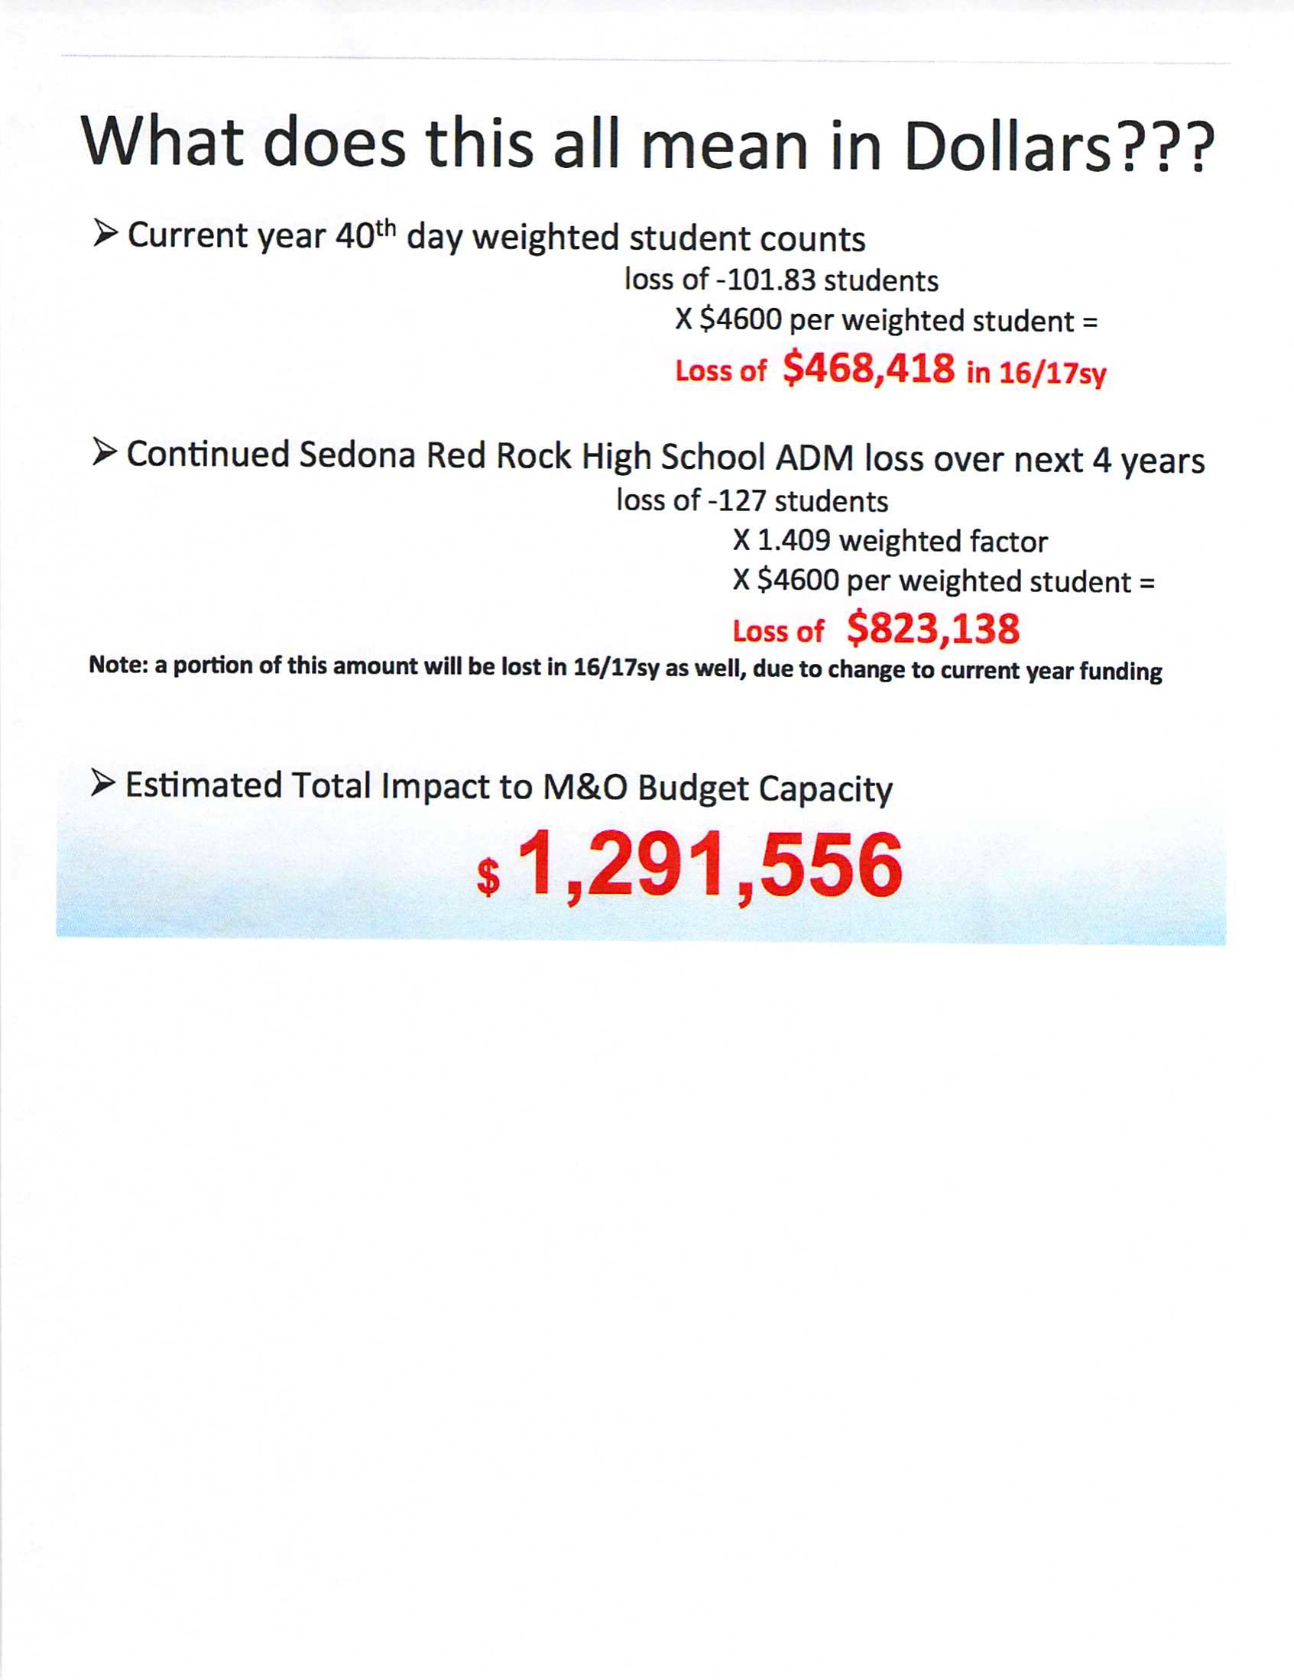

Slide 7
K-6, K-6, 7-12 Campuses

Slide 13
Questions?
K-6, K-6, 7-12 = $ 883,400
    Instructional Dollars $730,400
    Admin/DW Services $109,000
    Other $44,000
District Wide Services = $ 164,400
Total = $ 1,047,800

Slide 15
K-6, 7-12 Campuses

Slide 19
Additional Items
Building Utility savings – $130K - $230K
Possible Rental Revenue –
    At 25% room capacity $47.2 - $81K
    At 50% room capacity $94.5 - $162K
    At 100% room capacity $189 - $324K
      Excludes non-classroom areas (office, MP, cafeteria, etc)

Slide 20
Additional Items
Transportation Items
    Both 7-12 models will have transportation factors.
    Staggered start times?
    Additional route costs vs. reduced routes?
    City traffic flow, route times, etc.
    Operational Restructure?
      In house vs. contracted services

Slide 21
Questions?
K-6, 7-12 = $ 1,083,540 - $ 1,218,540
    Instructional Dollars $733,540
    Admin/DW Services $128,000
    Other $33,000
    * Utilities/Rental $189,000 - $324,000
District Wide Services = $ 164,400
Total = $ 1,247,940 - $ 1,382,940

Slide 23
Current Model-
K-8, K-8, 9-12 Campuses

Slide 29
Questions?
Current Model = $999,950
    Instructional Dollars $830,950
    Admin/DW Services $114,000
    Other $55,000
District Wide Services = $ 164,400
Total = $ 1,164,350

Slide 31
Recap $$$
K-6, K-6, 7-12 = $ 1,047,800
    Instructional Dollars $730,400
    Admin/DW Services $109,000
    Other $44,000
    District Wide Services = $ 164,400
K-6, 7-12 = $ 1,247,940 - $ 1,382,940
    Instructional Dollars $733,540
    Admin/DW Services $128,000
    Other $33,000
    Utilities/Rental $189,000 - $324,000
    District Wide Services = $ 164,400
Current Model = $ 1,164,350
    Instructional Dollars $830,950
    Admin/DW Services $114,000
    Other $55,000
    District Wide Services = $ 164,400

Slide 32
Let’s Not Lose Sight
Salaries & Benefits!!!
Running parallel as we move through this process.
Admin team is looking at how our employees get more money in their pockets via salaries and benefits.
Prop 123 – If passes, starting teacher pay >$30K.
    10% increase in starting teacher pay

Slide 33
Goal Statements
1. Utilize data to establish and ensure that all students are provided an efficient curriculum delivery model that enables their academic, emotional and cultural needs to be met.
2. As a unified School District, we will make decisions with the end goal of college and career readiness, which sustains and improves programs for all k-12 students. This will begin in Kindergarten and culminate upon graduation of high school and beyond.
3. Develop and implement a district wide instructional model that will be fiscally sustainable and capable of offering our students a variety of choices and options for a diverse and dynamic education.
4. Model will foster a research-based, guaranteed and viable curriculum aligned both vertically and horizontally that best meets the needs of all students k-12.
5. The restructuring model will create a system that allows financial resources to be dedicated to creating and maintaining a competitive salary schedule.
Identify high school graduate academic and emotional goals
All students, k-12 focus!
Work within our budget
Articulated District Curriculum
Increase teacher salaries
Internal Marketing Program

Slide 34
Community Input
Ideas, thoughts, points of clarification

Slide 35
Wrap up

