Slide 1
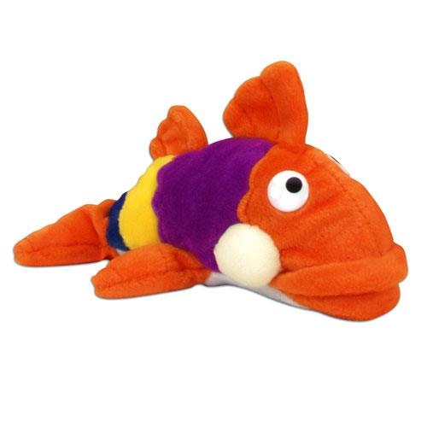
3/6/18 Board Presentation

Slide 2
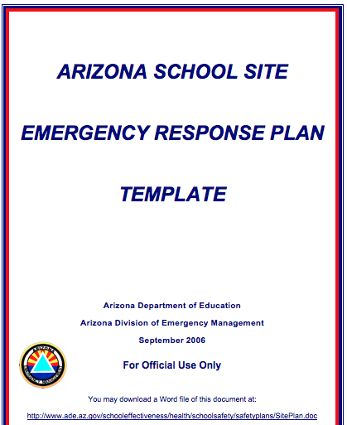
Emergency Reponses Plan

Slide 3
Types of Drills
1. Fire Drills: a. held monthly b. teachers carry their class list and emergency kit with them c. teachers takes attendance and report any missing student to Mr. Keller 2. Lock Down a. Incident Commander (Principal) initiates all lock downs b. one per semester c. students move to the nearest room d. staff follows the lock down procedures 3. Evacuation: a. Incident Commander (Principal) initiates all evacuations b. one per semester c. staff follows the evacuation checklist

Slide 4
Communication
presentation to the Site Council in August
information via Facebook
information via Auto Call
Training for Staff
1. beginning of year-presentation with resource officer
2. mid-year training on Active Shooter
3. special training for members of the Crisis Team

Slide 5
Safety Team
Principal Scott Keller Teacher Don Burton Counselor Tom Parsons Front Office Staff Member Amanda Raucci Resource officer: Jackie McQuaid

Slide 6
Involvement from Outside Agencies
Sedona Police Department Sedona Fire Department Yavapai County Sheriff’s Office

