Slide 1
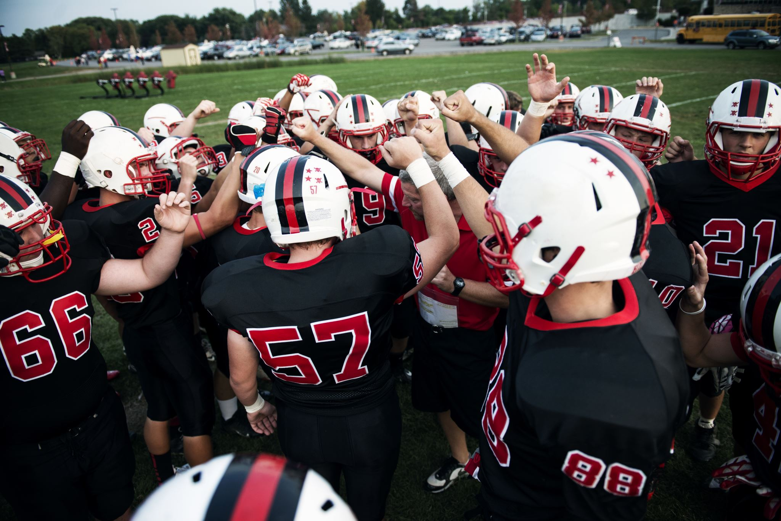
SCORPION ATHLETICS: Can Sedona Red Rock High School sustain the current 11-man football program?

Slide 2
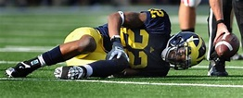
The Factors we considered in attempting to answer the question:
A. Number of Participants:
1. Our team has averaged 25 players as each season has begun over the past 4 years
2. Our team has averaged 15.5 players at the end of each season
3. Our team has been made up of 7.75 Seniors during the past four seasons
B. How the Number of Participants Increase the Possibility of Injuries:
1. The number of injuries increase as the number of participants force the coach to use all
players both ways (Offense and Defense).
2. When key players are injured it forces the coach to move players around due to limited
numbers. Example—Last year we lost two key players for most of the season.
C. Cost of the Program:
1. The Cost includes Coaching salaries + benefits, Transportation, Custodian, Cost of Lighting,
Cheerleading Coach, AIA Fees, Equipment and Officials.
2. The revenue includes Participation fees for players and gate receipts.

Slide 3
Participation:
Year # of participants #of participants Seniors on the Team
at the START at the END
25 18 7
2017 25 15 8
2018 27 16 10
2019 23 14*** 6
Football Candidates returning for 2020 (Estimate)
Seniors to be: 5*
Juniors to be: 5**
Sophomores to be: 0
Freshman to be: unknown
*two players were inured or ineligible for most of the season
**one player was injured most of the season
***This number does not include the two players that did not finish the season due to injuries

Slide 4
Cost for the Football Program from 2019
Expenses:
Equipment $800.00
(new uniforms were supplied by a donor)
Coaching Salaries: $8400.00
Coaching Benefits (22%): $1848.00
Officials: $2463.70
Totals: $13511.70
Receipts:
Student Participation Fees: $1500.00
Gate Receipts: (Approximate) $3000.00
Total: $4500.00
Loss: -$9011.70
The figures do not include the following:
Transportation (Depends on the Away Schedule at $3.95/mile)
Custodian (Hourly rate for 5 Home Games—Approximately 6 hours/night)
Lighting Cost (Approximate Cost is $100.00/Hour---25 Hours for 5 Home games)
Cheerleading Coach ($1500.00 + benefits)
Cost for Football to be included as a sport for AIA ($427.10/sport)

Slide 5
Football Scores during the past six seasons:
Year Offensive Pt. Average Defensive Pt. Average + or - Record Enrollment***
*2019 18.7 (187) 37.0 (370) -18.3 2-8 308
2018 21.4 (214) 31.5 (315) -10.1 3-7 312
2017 18.0 (162) 52.0 (468) -34.0 0-9 342
2016 14.6 (146) 22.4 (224) -7.8 2-8 384
**2015 34.3 (343) 15.5 (155) +18.8 7-3 444
*One game vs: Rock Point (52-6) Offensive -135 (15.0) Defensive (364 (40.4) -25.4
**6 Reservation Teams—221(36.8) -62 (10.3) = 5-1 (Smaller Numbers-More Travel-Weaker Teams)
***Enrollment as of Sept. 1 each year

Slide 6
Interventions:
Things that have been done during the past two years to increase the possibility of fielding a successful 11-man football team:
1. The employment of an extremely successful coach (Bob Young)
and connecting him with a weight class taught for PE credit. This
gave Coach Young access to athletes to recruit to the football
program and help maintain their eligibility by monitoring grades.
2. The state divided the weaker teams (based on records and #
of participants) into two divisions.
3. The initiation of a Junior High Football team. We played two games and
lost them by scores of 0-55 and 6-60. We were again hurt by
numbers due to more than half of the participants being ineligible
due to grades. None of the local Junior Highs play football which
resulted in trips of over 3 hours for games.
4. Petitioned AIA to allow our school move from 11-man to 8-man
football. They rejected the move both times.

Slide 7
Conclusion: Our Administrative team would ask that we eliminate the football program for 2020-21
for the following reason
1. Lack of participants that can be sustain an 11-man football program.
a. the concern is also for the reduced number of students that might
consider playing football.
2. The concern for serious injuries increases with the limited participants.
a. players having to play full time both ways
b. players not making the Athletic Training staff aware of an injury
to enhance the team’s chance of success.
c. Nationwide concern about concussions from participating in football
3. The COST of the program vs: the number of participants.
4. The concern of having to cancel games at a late notice which results in
a penalty which is enforced by the AIA ($1500.00).
5. The concern of fairness to other schools as they form their football schedules.

Slide 8
QUESTIONS?

